Slide 1
Lagrange Interpolation

Slide 2
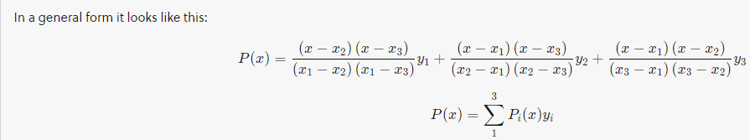
What is Lagrange method of interpolation?
The Lagrange interpolation formula is a way to find a polynomial, called Lagrange polynomial, that takes on certain values at arbitrary points.
Lagrange's interpolation is an Nth degree polynomial approximation to f(x).
In a general form it looks like this:

Slide 3
Why do we use Lagrange interpolation?
Advantages of Lagrange Interpolation: This formula is used to find the value of the function even when the arguments are not equally spaced.
This formula is used to find the value of independent variable x corresponding to a given value of a function.

Slide 4
Lagrange’s interpolation formula
The Newton’s forward and backward interpolation formulae can be used only when the values of x are at equidistant.
If the values of x are at equidistant or not at equidistant, we use Lagrange’s interpolation formula.

Slide 5
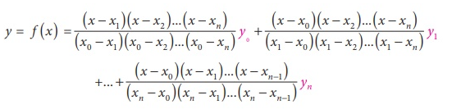
Lagrange’s interpolation formula
Let y = f( x) be a function such that f ( x) takes the values y₀ , y₁ , y₂ ,......., y_{n} corresponding to x= x₀ , x₁, x₂ ..., x_{n}
That is y_{i} = f(x_{i}),i = 0,1,2,...,n . Now, there are (n + 1) paired values (x_{i}, y_{i}),i = 0, 1, 2, ..., n and hence f ( x) can be represented by a polynomial function of degree n in x.
Then the Lagrange’s formula is

Slide 6
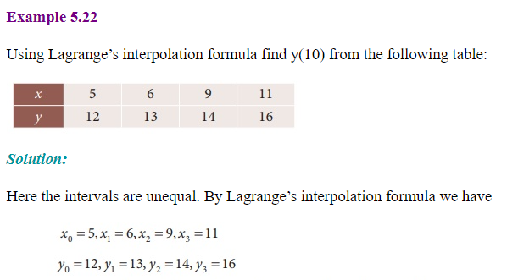
Lagrange’s interpolation formula

Slide 7
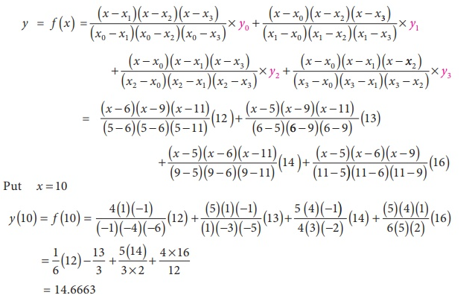
Lagrange’s interpolation formula

Slide 8
